Slide 1

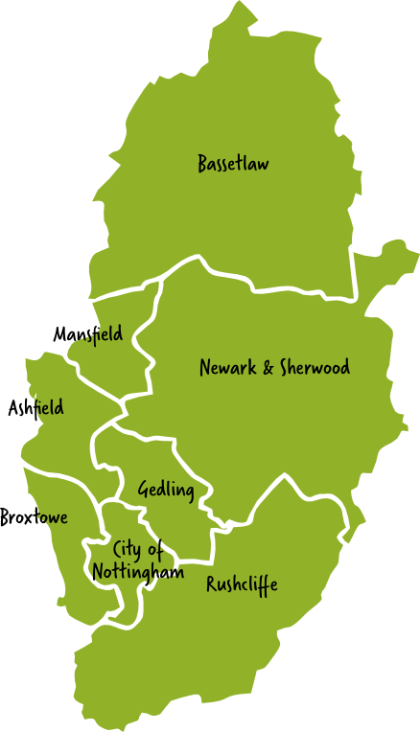




1
Misson
12
Shelton
1
22
12,000
15,000
21
2
Scrooby
13
Newark
2
20
20,000
13,000
3
Worksop
14
Collingham
19
30,000
5,000
The 10,000 Steps a day Challenge
Join our 10,000 a day Step Challenge – the equivalent of walking all the way around Nottinghamshire.
What’s the Challenge?
Your mission, should you choose to accept it, is to walk or wheel 310,000 steps in a month. That’s 10,000 steps a day. As well as the fun of doing it, it’s also great for your physical and mental health and wellbeing.
What do you have to do?
Sign Up Now
Walk or Wheel in a way and a place that suits you e.g. round your home or garden; in your neighbourhood; on a treadmill; or in a green space; to work, the shops or during your lunch break; going on your own or with family and friends
Track Your Steps - Use your phone, pedometer, or fitness tracker to record how many steps you take and log them on the chart over the page
Share Your Journey - Join our virtual group to stay motivated, share photos, and celebrate milestones!
Let’s get Walking and Wheeling around Nottinghamshire…
3
4
Mansfield
15
Besthorpe
18
15,000
10,000
17
5
Kirkby
16
Wigsley
16
15,000
5,000
4
15
6
Eastwood
17
Thorney
14
15,000
10,000
7
Stapleford
18
Ragnall
5
13
20,000
15,000
8
Ratcliffe
19
Cottam
12
15,000
15,000
6
Bole
9
Rempstone
20
20,000
10,000
7
11
10
Hickling
21
Walkeringham
20,000
5,000
8
10
11
Sutton
22
Misterton
10,000
15,000
9
Back to
Misson
Notes:
1

Slide 2

How far round Nottinghamshire can we go?
STAGE | FROM | TO | STEPS | TOTAL | STAGE | FROM | TO | STEPS | TOTAL
1 | Misson | Scrooby | 12,000 | 12,000 | 12 | Shelton | Newark-on-Trent | 15,000 | 207,000
2 | Scrooby | Worksop | 20,000 | 32,000 | 13 | Newark-on-Trent | Collingham | 13,000 | 220,000
3 | Worksop | Mansfield | 30,000 | 62,000 | 14 | Collingham | Besthorpe | 5,000 | 225,000
4 | Mansfield | Kirkby-in-Ashfield | 15,000 | 77,000 | 15 | Besthorpe | Wigsley | 10,000 | 235,000
5 | Kirkby-in-Ashfield | Eastwood | 15,000 | 92,000 | 16 | Wigsley | Thorney | 5,000 | 240,000
6 | Eastwood | Stapleford | 15,000 | 107,000 | 17 | Thorney | Ragnall | 10,000 | 250,000
7 | Stapleford | Ratcliffe-on-Soar | 20,000 | 127,000 | 18 | Ragnall | Cottam | 15,000 | 265,000
8 | Ratcliffe-on-Soar | Rempstone | 15,000 | 142,000 | 19 | Cottam | Bole | 15,000 | 280,000
9 | Rempstone | Hickling | 20,000 | 162,000 | 20 | Bole | Walkeringham | 10,000 | 290,000
10 | Hickling | Sutton | 20,000 | 182,000 | 21 | Walkeringham | Misterton | 5,000 | 295,000
11 | Sutton | Shelton | 10,000 | 192,000 | 22 | Misterton | Misson | 15,000 | 310,000

Slide 3
Nottinghamshire - The 10,000 Steps a Day Challenge - Personal Walking Log
Use your phone, pedometer, or fitness tracker to record how many steps you take during May and log them on the chart below.
Date | Thursday | Friday | Saturday | Sunday | Monday | Tuesday | Wednesday | Weekly Total | Running Total

Slide 4
Nottinghamshire - The 10,000 Steps a Day Challenge - Team Walking Log
Collect your team’s personal walking logs and record your total steps as a group on the chart below.
Date | Thursday | Friday | Saturday | Sunday | Monday | Tuesday | Wednesday | Weekly Total | Running Total

