Slide 1

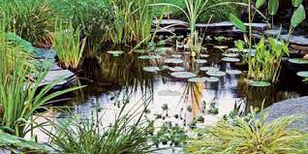
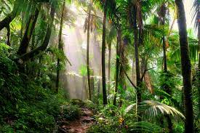
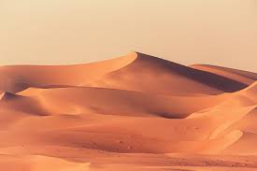

King Edwin Primary School
Main Learning: Living Things and their Habitats | Year 2 | Subject: Science
Key knowledge
Why do animals choose the habitats they have?
Know whether things are living, dead or have never lived.
Identify and name plants and animals in a range of habitats.
Know how a specific habitat provides for the basic needs of things living there.
Match living things to their habitat.
Know about the lives of important people in living things and their habitats.
Vocabulary
animals | Living creatures that move, eat and have senses like us.
habitats | Places where animals and plants live and find what they need to survive.
microhabitat | A place where an organism lives, but on a much smaller scale.
species | A group of animals, plants or other living things that all share common characteristics and that are all classified as alike in some way.
adaptation | How living things change to survive and thrive in their environments.
environment | The surroundings or conditions in which a person, animal, or plan lives or operates.
 | Prior Knowledge –

