Slide 1
King Edwin Primary and Nursery School
Parent Information Evening
Thursday, 20th June 4pm

Slide 2
Welcome Parents!
We can’t wait to have you as part of our KingEdWINNER team

Slide 3
School Values
The EYFS (F2) is very much a part of TEAM KEPS.
Our children are enthusuaitc about our HIGH 5 VALUES
RESPECT
GOOD CHOICES
DETERMINATION
CREATIVITY
EXCELLENCE

Slide 4
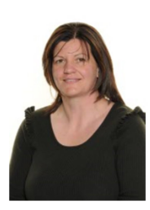
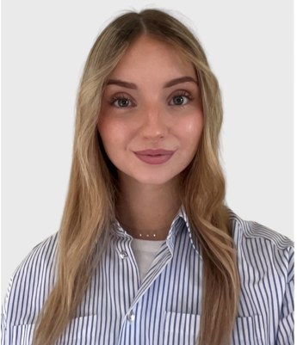
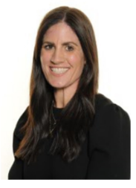
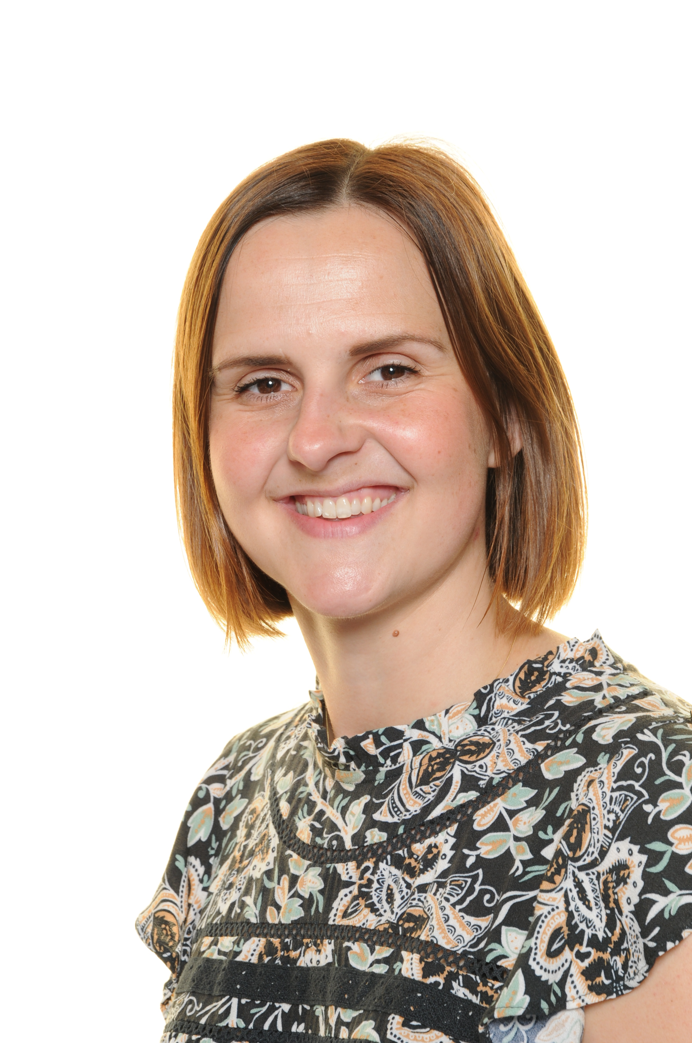
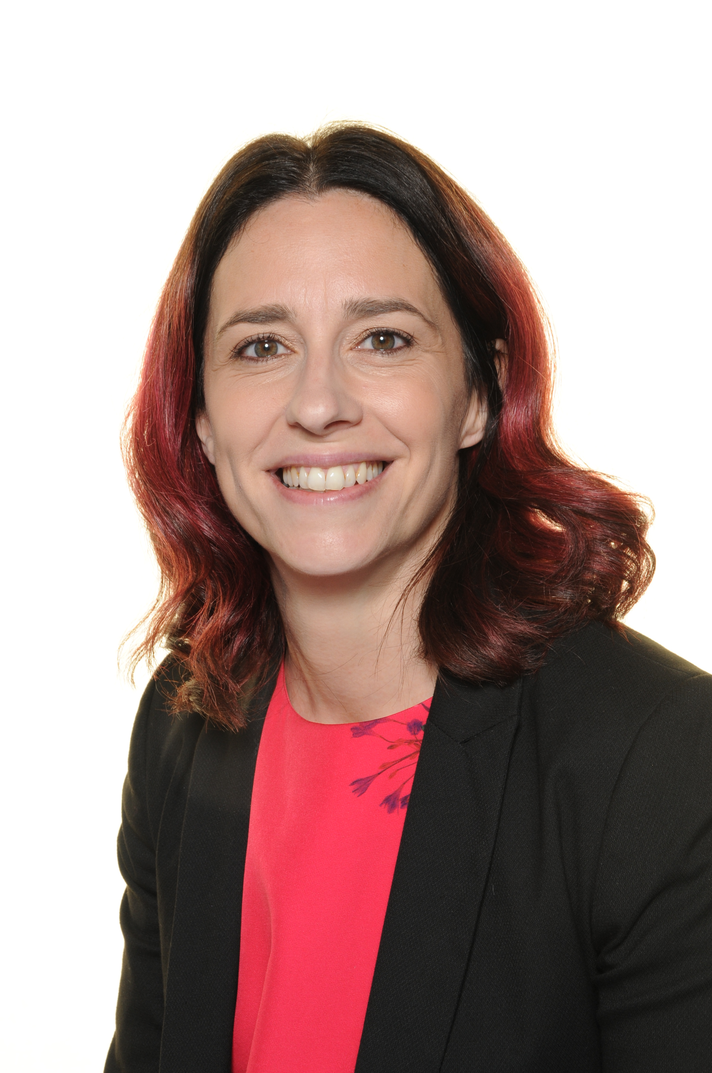
Fox class
Miss Farrow
Additional
Teacher
Mrs Stafford
FOX CLASS TEACHER
EYFS lead
Mon-Thurs
Mrs Sharp
FOX CLASS TEACHER
EYFS lead
Forest School lead
Weds -Fri
Mrs Porter
Teaching Assistant
Miss Wright
Support Staff

Slide 5
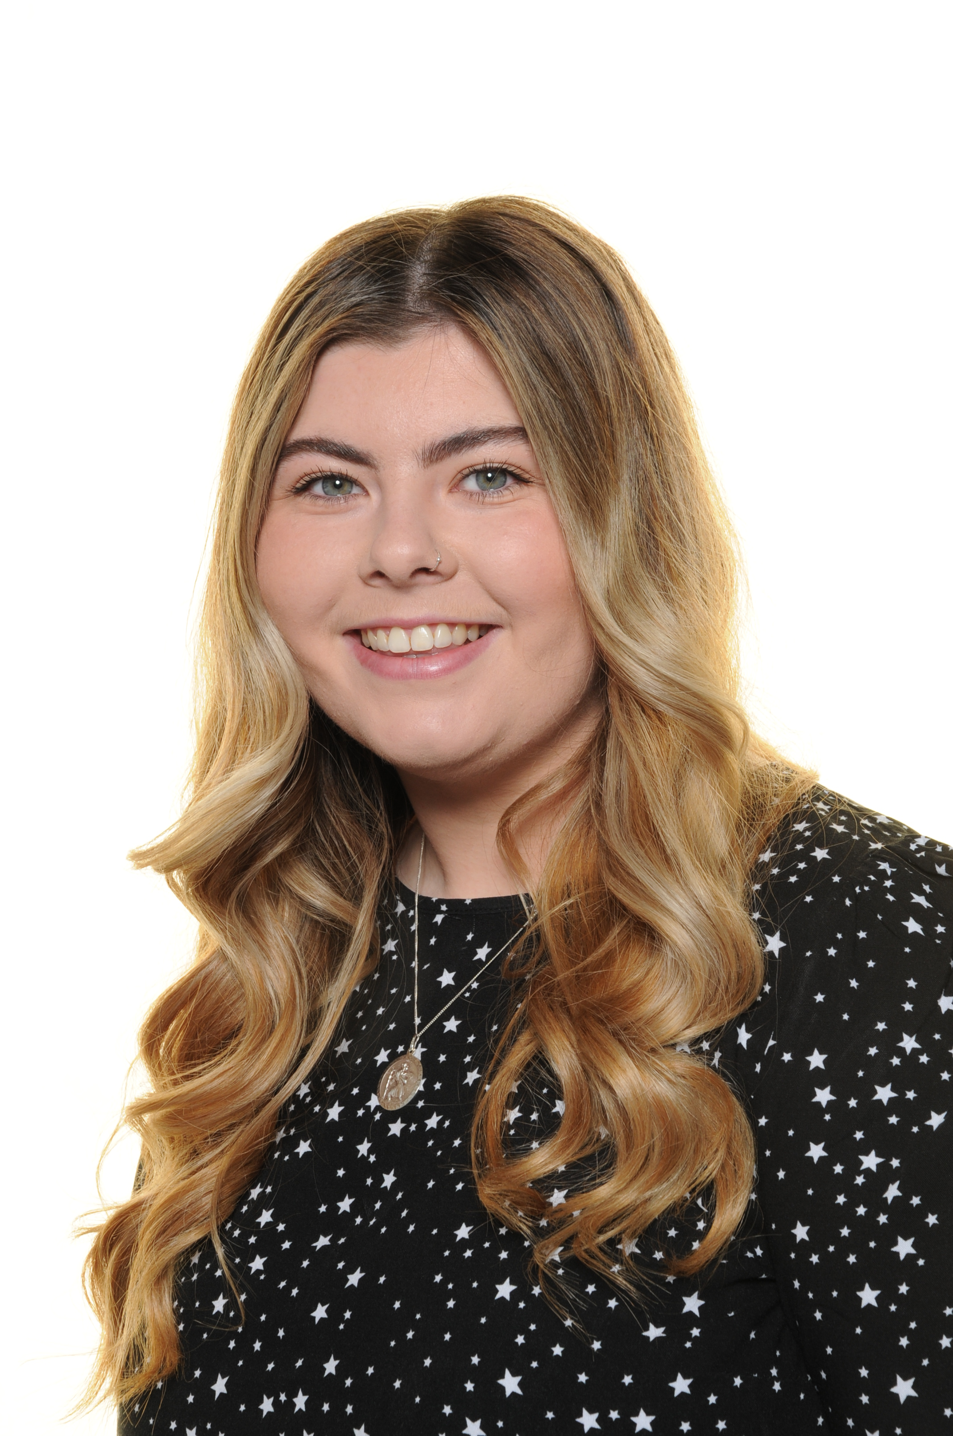
Badger class
Miss Farrow
Additional
Teacher
Miss Maude
BADGER CLASS
TEACHER
Mrs Porter
Teaching Assistant
Miss Wright
Support Staff

Slide 6
Should you need us…
01623 822111
office@kingedwin.notts.sch.uk
jstafford@kingedwin.notts.sch.uk
ssharp@kingedwin.notts.sch.uk
lmaude@kingedwin.notts.sch.uk

Slide 7
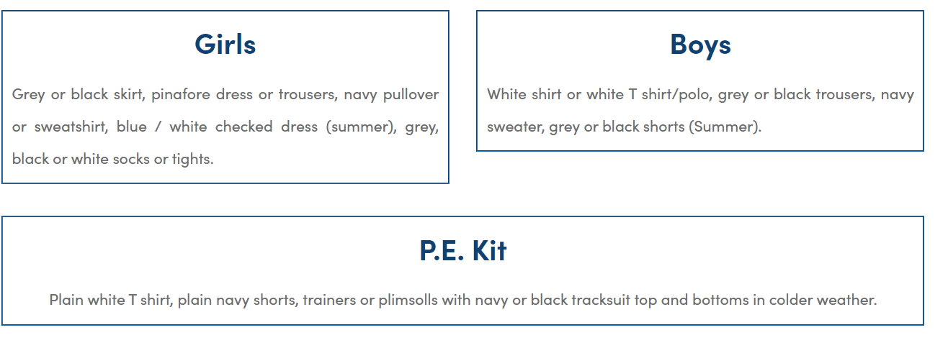
uniform
PE kit to be worn instead of uniform on Monday (PE day)

Slide 8
dates
Full day transition Wednesday 3rd July
Bring packed lunch
Transition booklet will be provided
Transition activity will be shared
First day of school: Tuesday 3rd September
School day times will be 8:50am- 3:20pm

Slide 9
Curriculum areas and expectations
prime areas:
• communication and language
• physical development
• personal, social and emotional development
specific areas:
• literacy
• mathematics
• understanding the world
• expressive arts and design
“Working towards” or “Working at”

Slide 10
Phonics
Rocket phonics- government accredited scheme
Daily
Whole class
Booklets
Tricky words
Stickers

Slide 11
Phonics booklets

Slide 12
examples

Slide 13
Sound mat 1

Slide 14
Sound mat 2

Slide 15
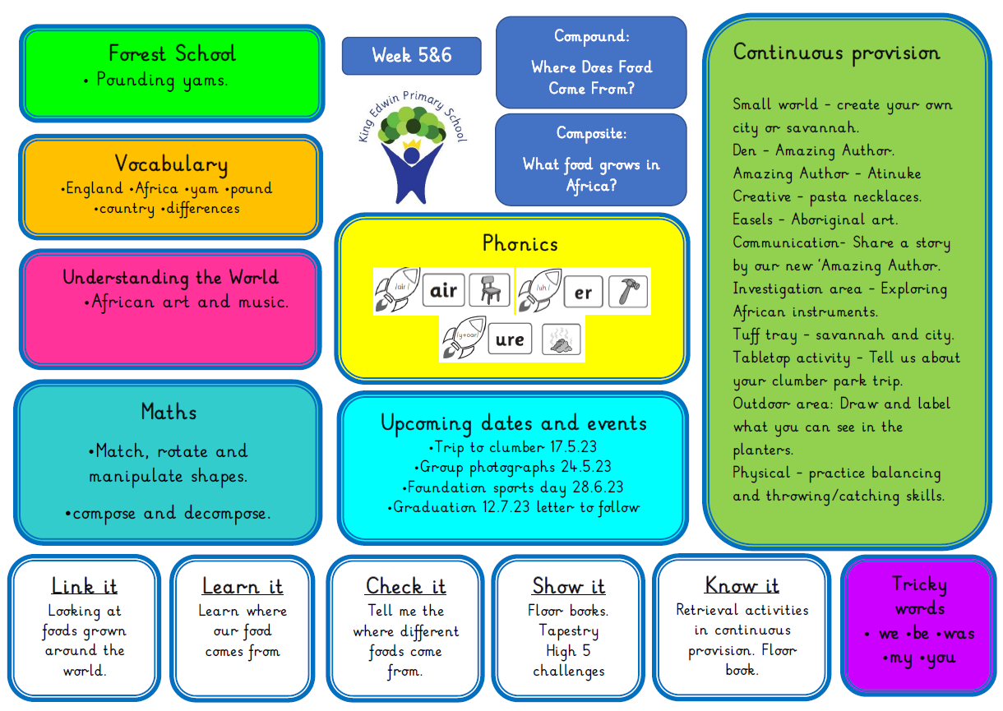
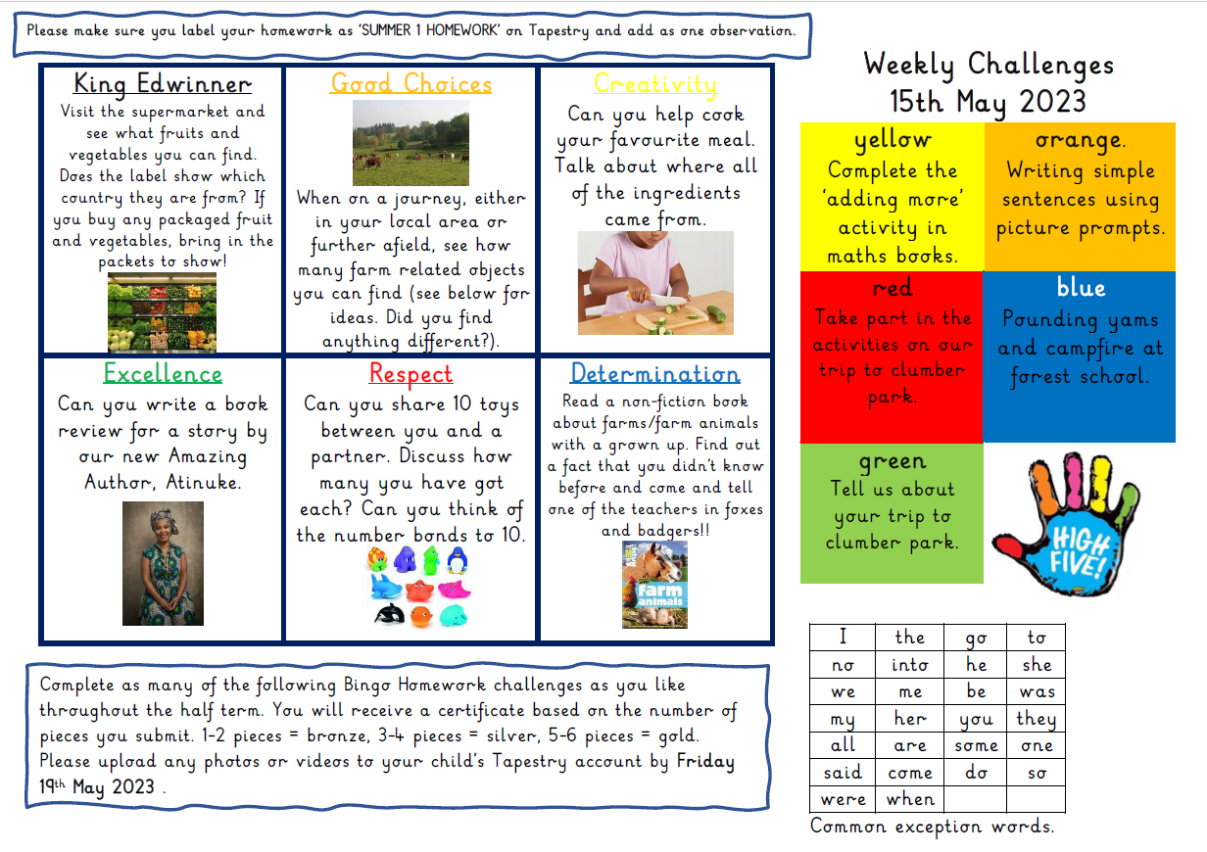
Keeping you informed
We send weekly newsletters to inform you of the units of learning. See examples on following slides.

Slide 18
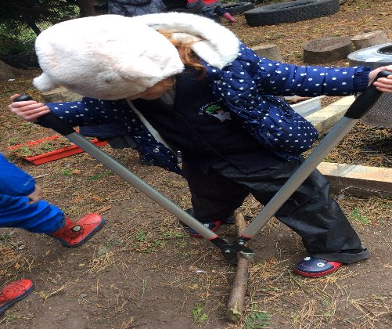
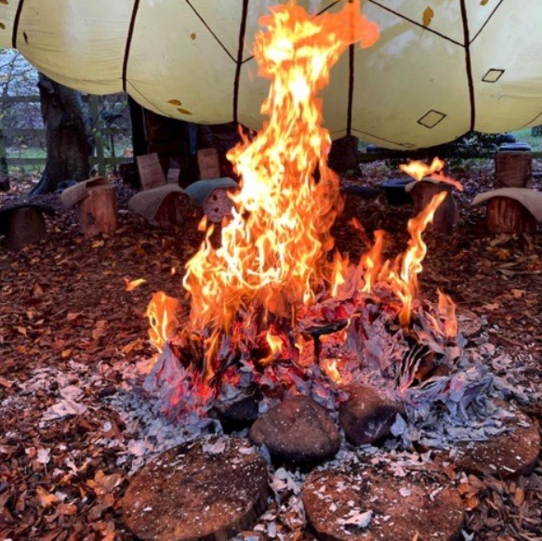
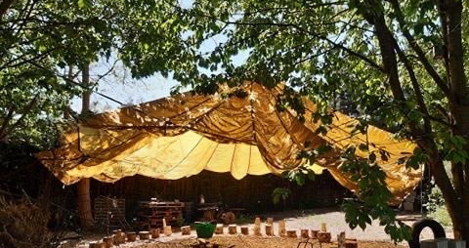
Forest School
Badgers- TUESDAY MORNINGS
Foxes- THURSDAY MORNINGS
On site in our designated area
Borrow waterproofs and wellies or bring your own in a bag
Make sure your child’s name is on EVERYTHING
Come to school ready to go on your day

Slide 19
Reception Baseline Assessment
Happens in first 6 weeks
Reported back to you in October at Parents meetings
Government use it as a measure of school success in y6

Slide 21
Communication
These are the apps/ communication methods you will have access to.

Slide 22
School milk, school dinner, snack
Apply for free school milk via website coolmilk.com
This is free until your child’s 5th birthday and then there is a small charge
School dinners must be booked using the Gateway App- even if you are sending packed lunch from home
All children are provided with Universal Free School Meals until they finish Y2 (3 years of free meals)
Snacks are provided daily- healthy fruit/veg
We are a HEALTHY SCHOOL. Water to drink from home.
(No sweets or cakes to be given out on birthdays etc)

Slide 24
Ages 3-11
Email to register.
hello@thelimetrees.co.uk
Book sessions online.
www.TheLimeTrees.co.uk
Prices
Breakfast Club- £5.35
Afterschool club- £9.20
Holiday club full day- £26 (7:30am- 6pm)
Holiday club half day- £15
BEFORE SCHOOL:
Monday to Friday from 7:15am
AFTER SCHOOL:
Monday to Friday until 5:50pm

Slide 25
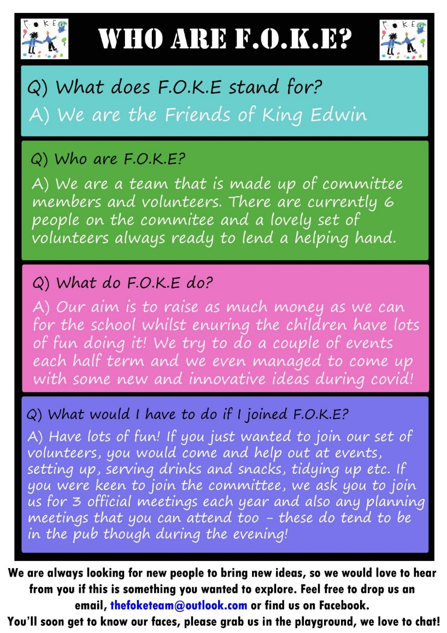

Slide 26
Medical
Book bags

