Slide 1
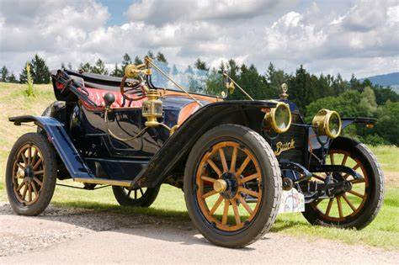
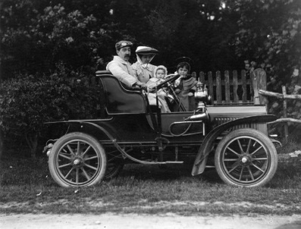
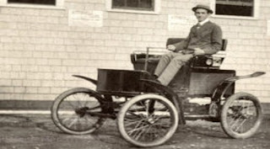
King Edwin Primary School
Main Learning: Moving Vehicle | Year 2 | Design and Technology
Key knowledge
Create a historical vehicle that moves on axles and wheels
Research what vehicles looked like in Victorian times
Design a vehicle that takes account of the historical period and incorporates axles and wheels
Gather the resources needed to make the vehicle
Ensure that in the making phase, the axles and wheels are strong enough
Evaluate the vehicle against the original design and explain how it could be made stronger
Vocabulary
vehicle | a thing used for transporting people or goods, especially on land, such as a car, lorry, or cart.
mechanism | a system of parts working together in a machine.
axles | a rod or spindle that passes through the centre of a wheel or group of wheels.
incorporate | take in or contain (something) as part of a whole.
Robert Anderson | Robert Anderson invented the first electric car in 1837.
 | Prior Knowledge –

