Slide 1
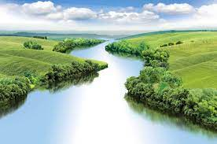
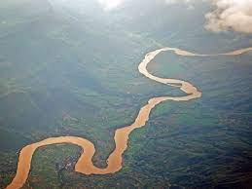
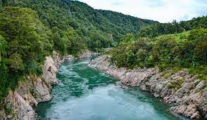
King Edwin Primary School
Main Learning: Rivers | Year 3 | Subject: Geography
 | Prior Knowledge –
Key knowledge
Know how a river is formed
Know the key physical features associated with a river.
Know that rivers end up entering the sea and this is called the estuary
Know what the water cycle is
Know the name of and can locate many of the world’s longest rivers, including the UK’s
Know what causes a flood and how people are trying to prevent it.
Vocabulary
deposition | Rocks and sediments eroded from one part of the river are deposited in another part
erosion | Erosion occurs when the fastest currents in the river carve into the banks
estuary | An estuary is an area where a freshwater river or stream meets the ocean
meander | A meander is a winding curve or bend in a river
source | The source of a river is where it begins, usually on high ground
tributary | When one stream or river meets another and merge together, the smaller stream or river is known as a tributary

