Slide 1
King Edwin Primary and Nursery School
Parent Information Evening
Thursday, 29th June 4:30pm

Slide 2
Welcome Parents!
SS
We can’t wait to have you as part of our KingEdWINNER team

Slide 3
School Values
JS
The EYFS (F2) is very much a part of TEAM KEPS.
Our children are enthusuaitc about our HIGH 5 VALUES
RESPECT
GOOD CHOICES
DETERMINATION
CREATIVITY
EXCELLENCE

Slide 4
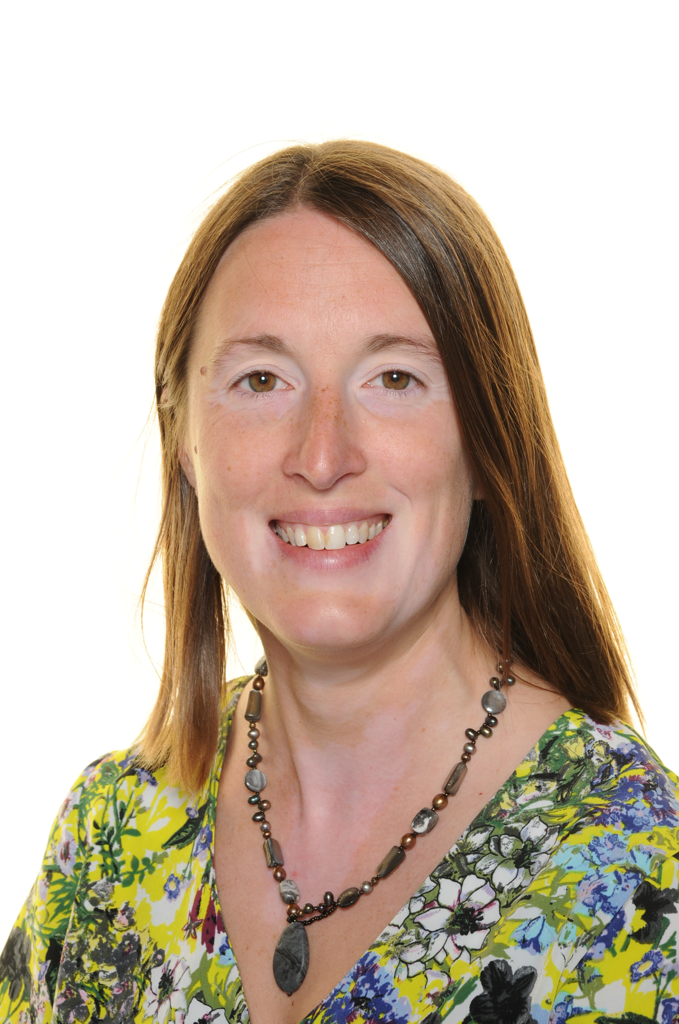
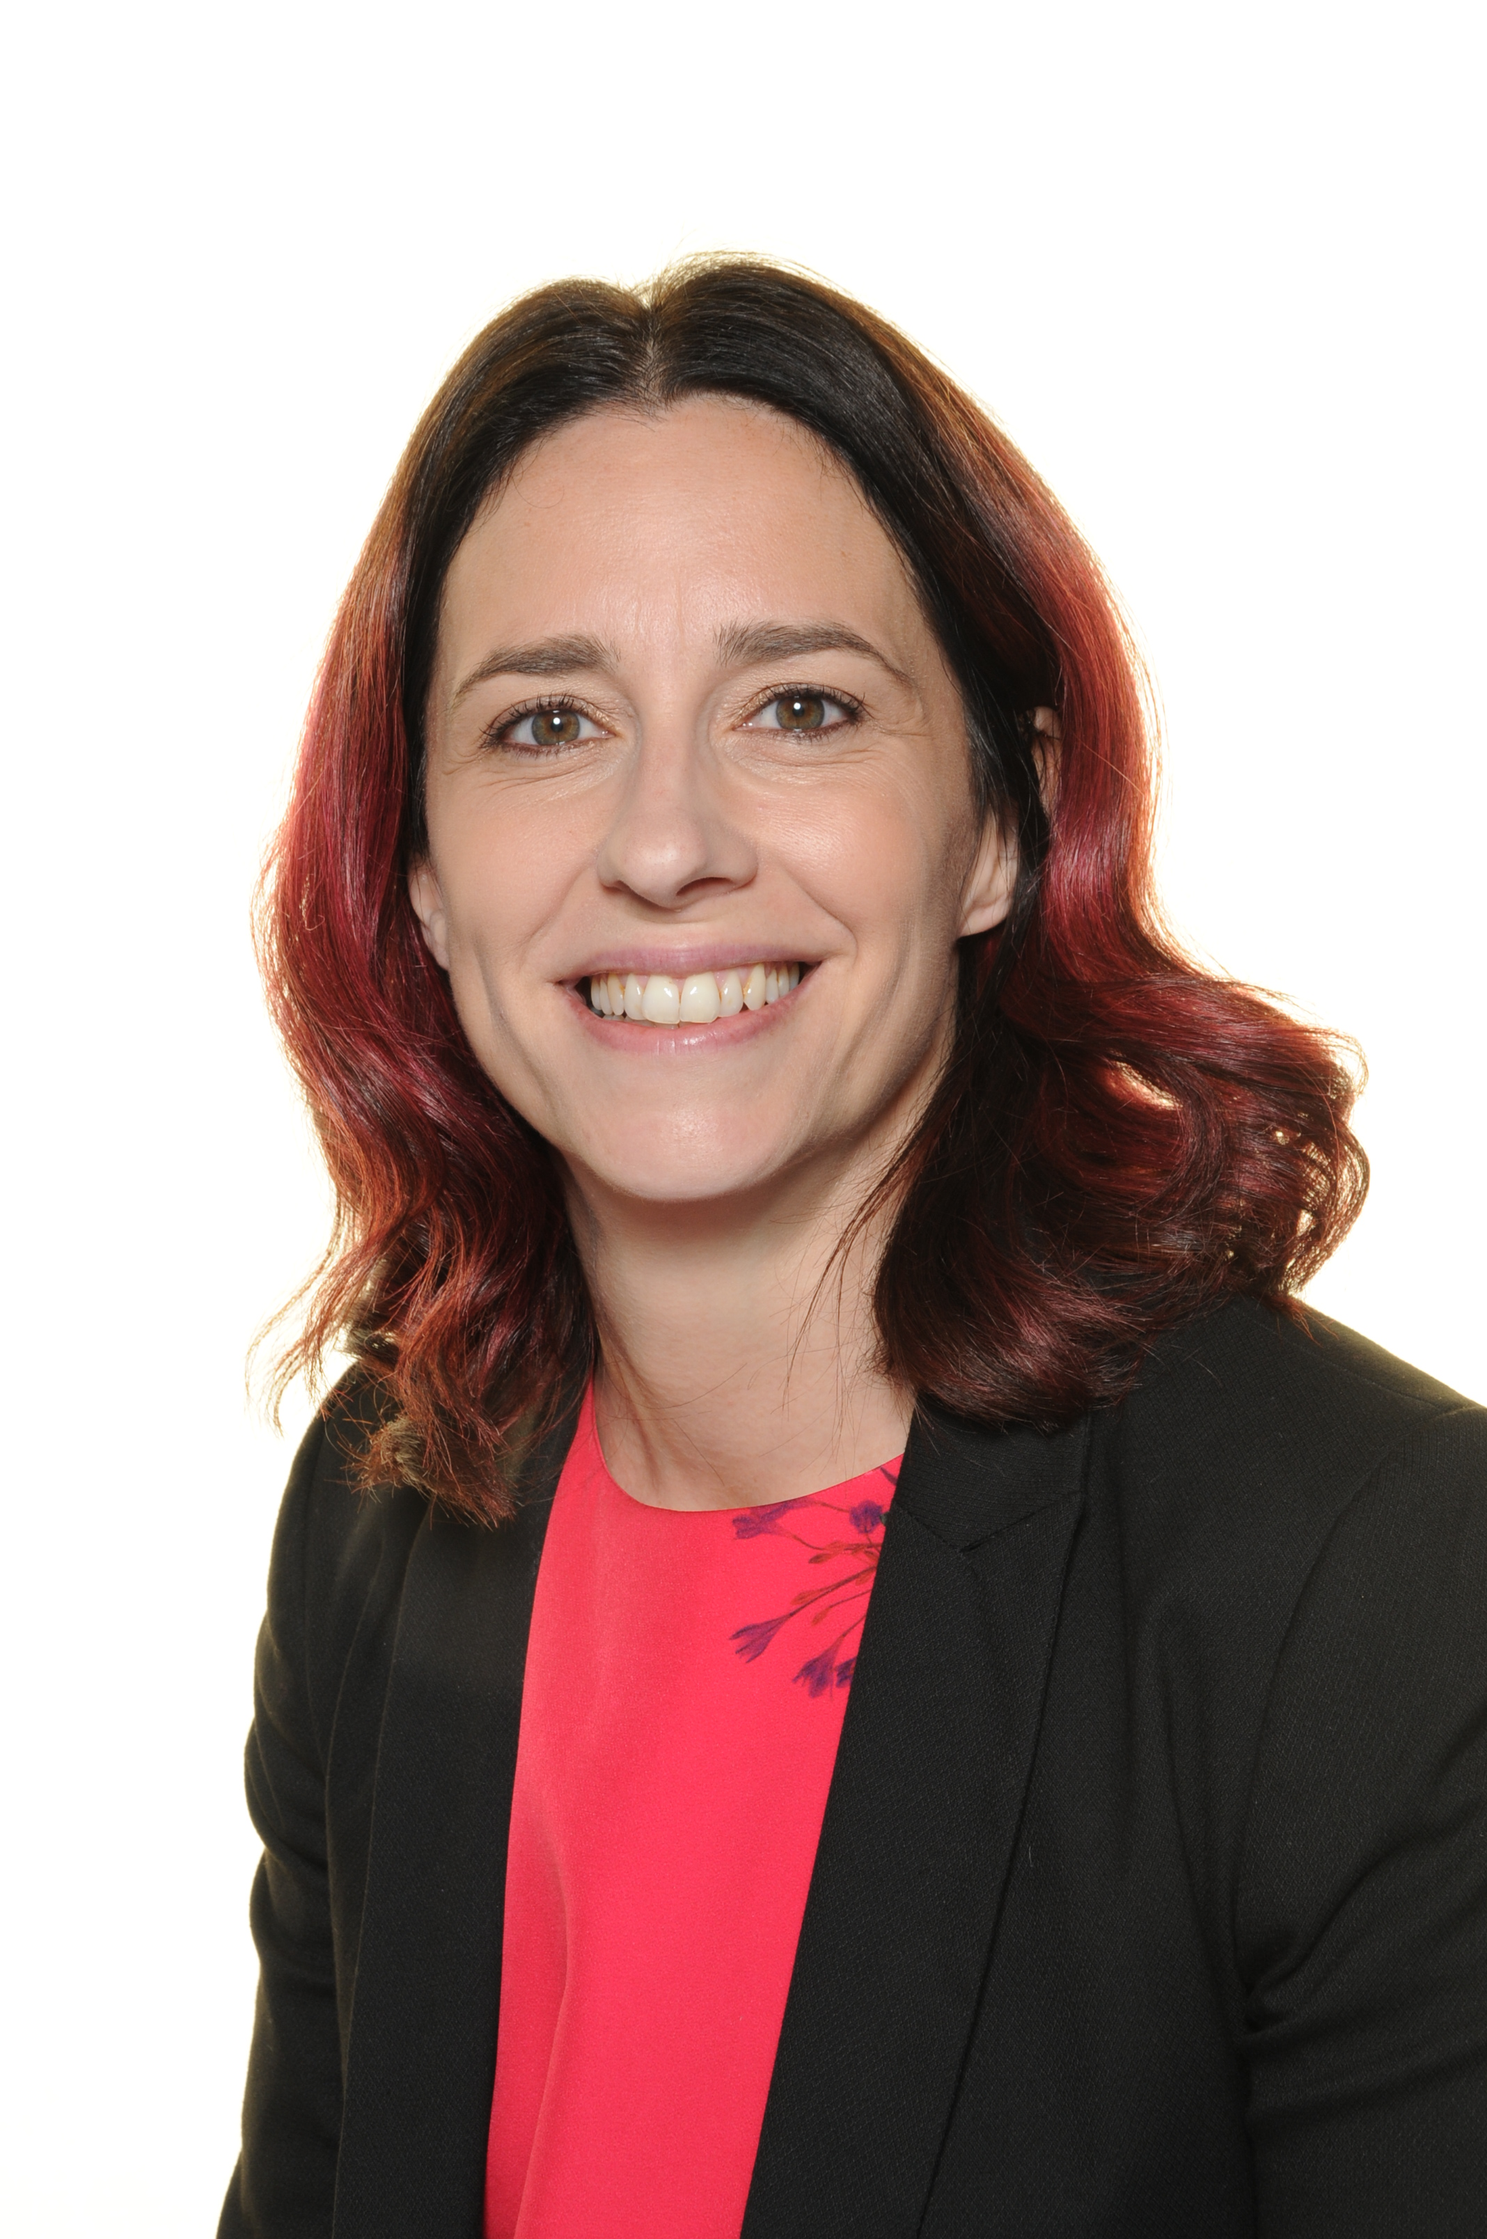
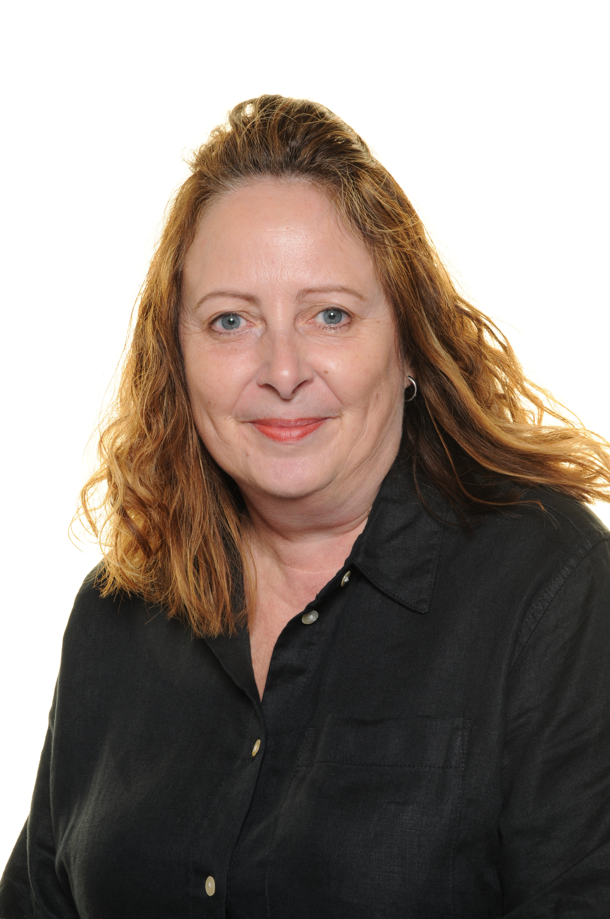
Fox class
SS
Miss Wilson
Care Worker
Miss Farrow
Additional
Teacher
Mrs Sharp
FOX CLASS TEACHER
EYFS lead
Forest School lead
Mrs Grant
FOX CLASS TEACHER
Mrs Gill
Teaching Assistant
Mrs Skennerton
Apprentice TA
Mrs Pritchard
Apprentice TA
Mrs Porter
Teaching Assistant

Slide 5
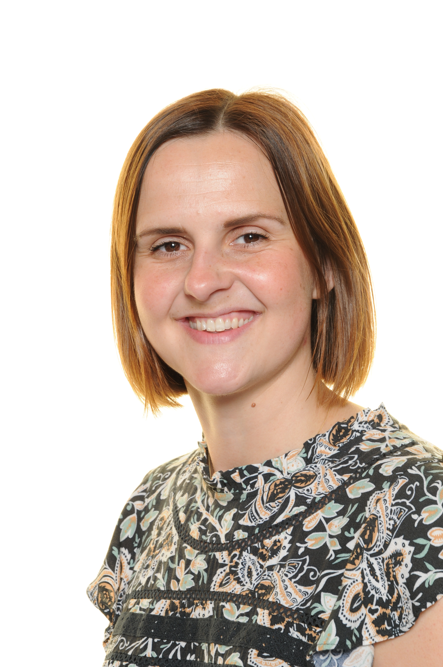
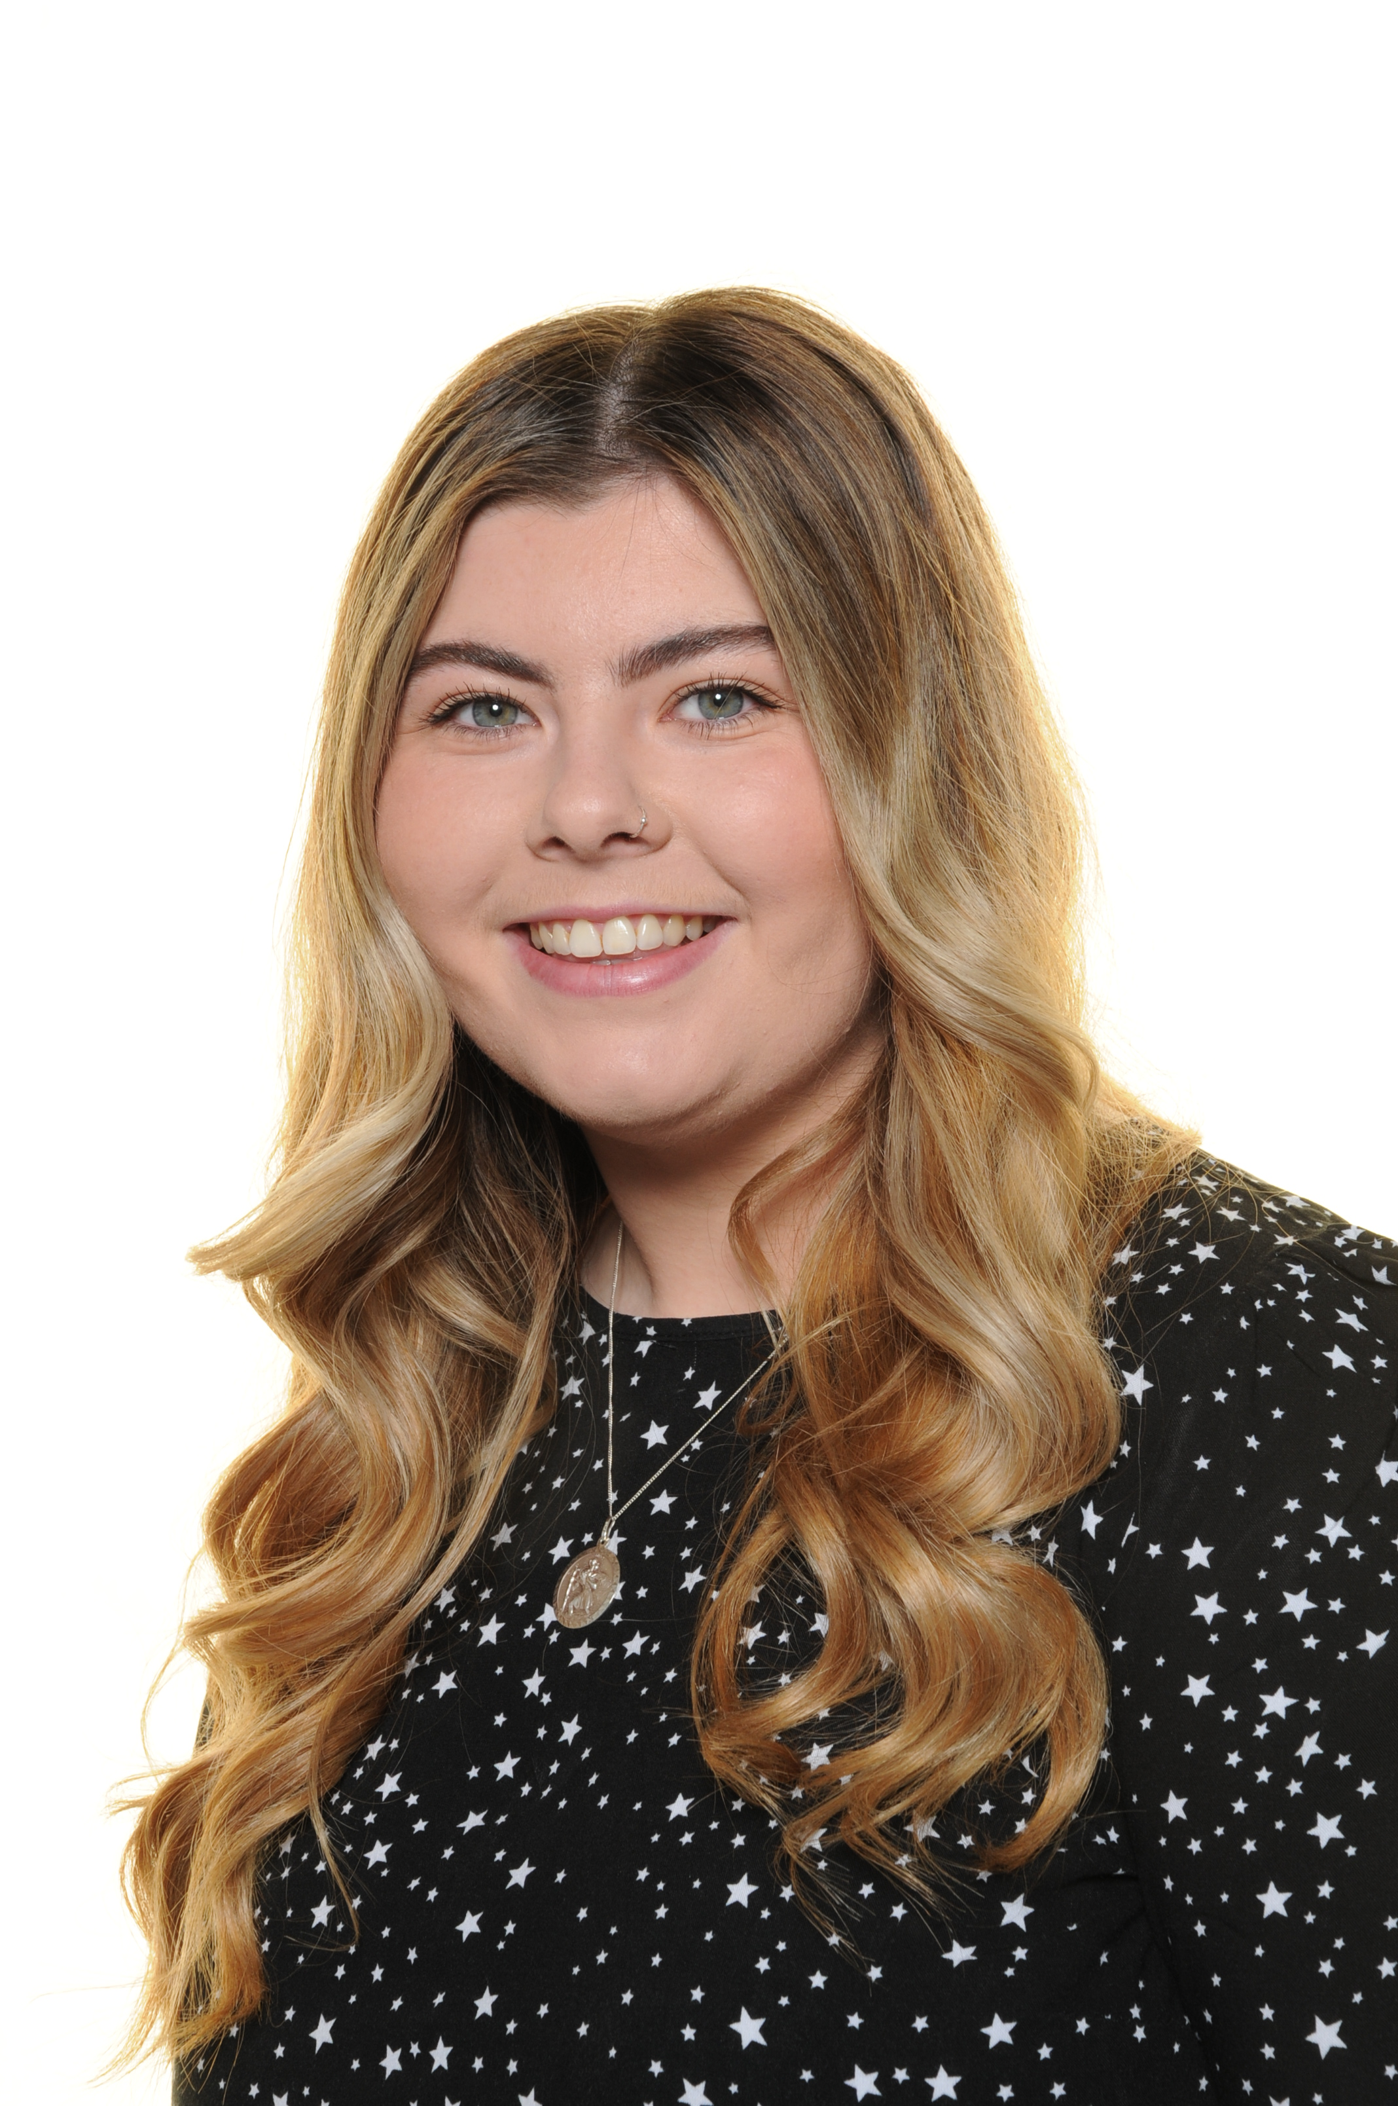
Badger class
LM
Miss Wilson
Care Worker
Miss Farrow
Additional
Teacher
Miss Maude
BADGER CLASS
TEACHER
Mrs Stafford
EYFS lead
Mrs Gill
Teaching Assistant
Mrs Skennerton
Apprentice TA
Mrs Pritchard
Apprentice TA
Mrs Porter
Teaching Assistant

Slide 6
Should you need us…
SS
01623 822111
office@kingedwin.notts.sch.uk
jstafford@kingedwin.notts.sch.uk
ssharp@kingedwin.notts.sch.uk
lmaude@kingedwin.notts.sch.uk
sgrant@kingedwin.notts.sch.uk

Slide 7
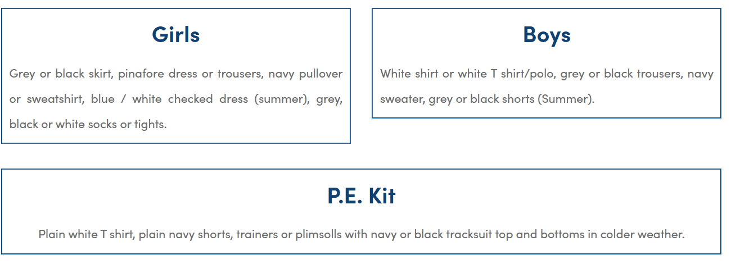
uniform
JS
PE kit to be worn instead of uniform on Monday (PE day)

Slide 8
What’s new?
LM
Building
Resources
Currciulum
… but what is long standing, secure, experienced? SO MUCH

Slide 9
Dates
Half day transition Thursday 13th July 9am-1:30
Bring a packed lunch
Come in via new classroom door
SS
Transition booklet
Transition activity
2 letters from staff- on transition, day before we start school
First day of school: Tuesday 5th September
New school day times 8:50am- 3:20pm

Slide 10
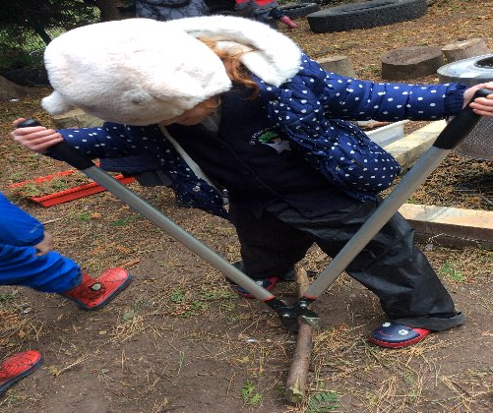
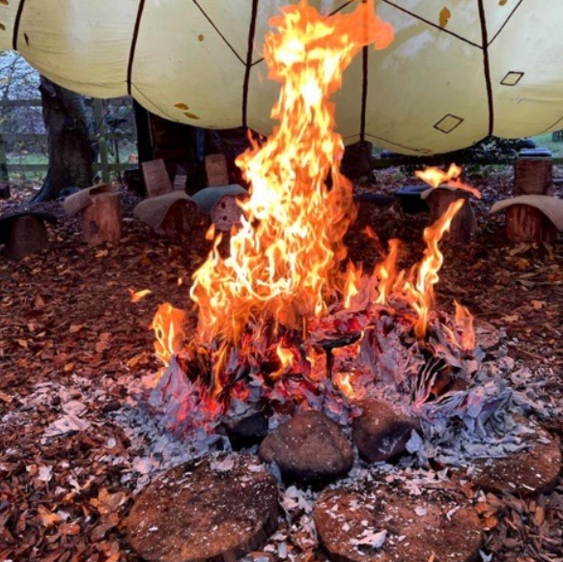
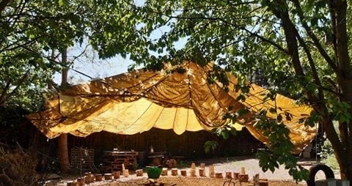
Forest School
JS
Wednesday mornings
On site in our designated area
Borrow waterproofs and wellies or bring your own in a bag
Make sure your child’s name is on EVERYTHING

Slide 11
Communication
LM
These are the apps/ communication methods you will have access to.

Slide 12
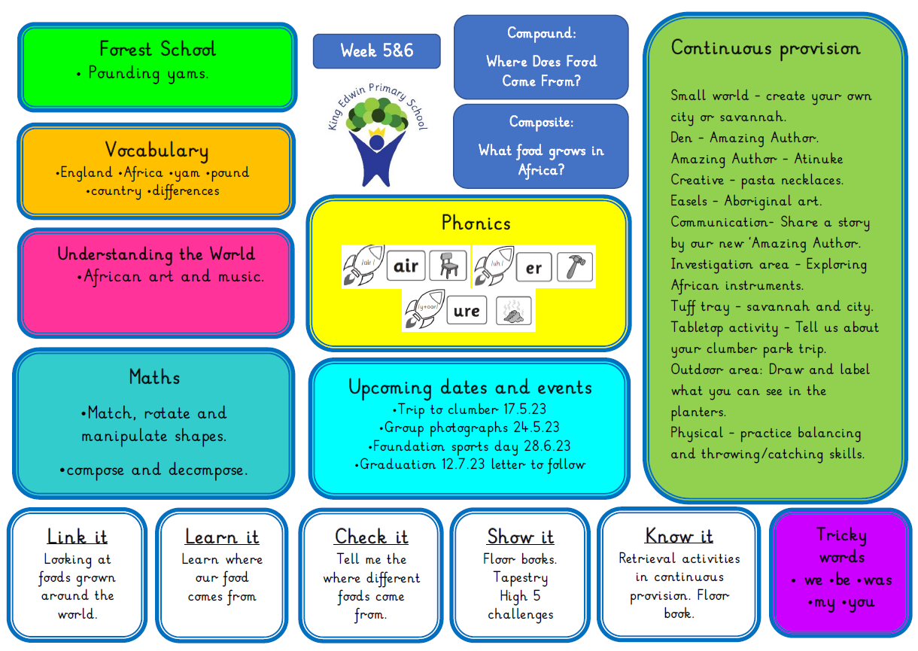
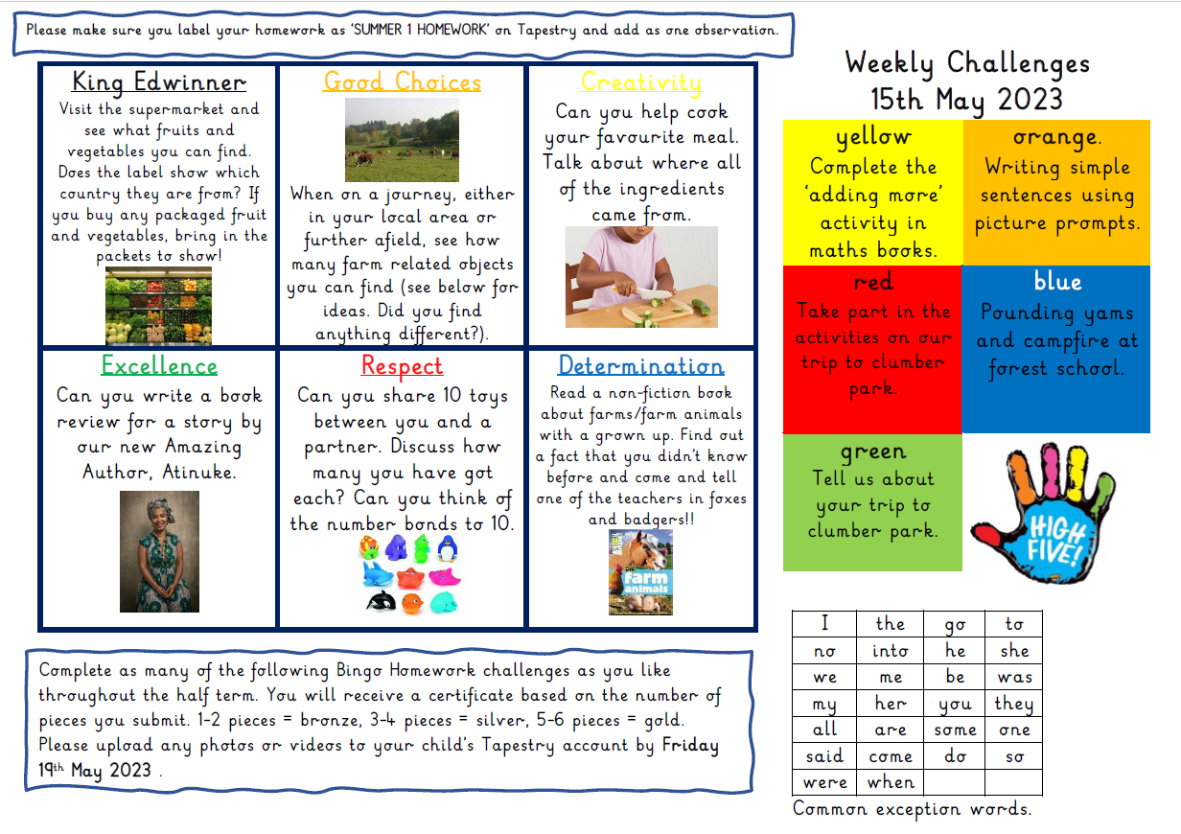
Keeping you informed
SS
We send weekly newsletters to inform you of the challenges and the units of learning. See examples on following slides.

Slide 13
JS

Slide 14
LM

Slide 15
Reception Baseline Assessment
SS
Happens in first 6 weeks
Reported back to you in October at Parents meetings
Government use it as a measure of a schools success in y6

Slide 16
School milk, school dinner, snack
JS
Apply for free school milk via website coolmilk.com
This is free until your child’s 5th birthday and then there is a small charge
School dinners must be booked using the Gateway App- even if you are sending packed lunch from home
All children are provided with Universal Free School Meals until they finish Y2 (3 years of free meals)
Snacks are provided daily- healthy fruit/veg
We are a HEALTHY SCHOOL. Water to drink from home.
(No sweets or cakes to be given out on birthdays etc)

Slide 17
LM

Slide 18
Curriuculm areas and expectations
SS
prime areas:
• communication and language
• physical development
• personal, social and emotional development
specific areas:
• literacy
• mathematics
• understanding the world
• expressive arts and design
“Working towards” or “Working at”

Slide 19
JS
Ages 3-11
Email to register.
hello@thelimetrees.co.uk
Book sessions online.
www.TheLimeTrees.co.uk
Prices
Breakfast Club- £5.35
Afterschool club- £9.20
Holiday club full day- £26 (7:30am- 6pm)
Holiday club half day- £15
BEFORE SCHOOL:
Monday to Friday from 7:15am
AFTER SCHOOL:
Monday to Friday until 5:50pm

Slide 20
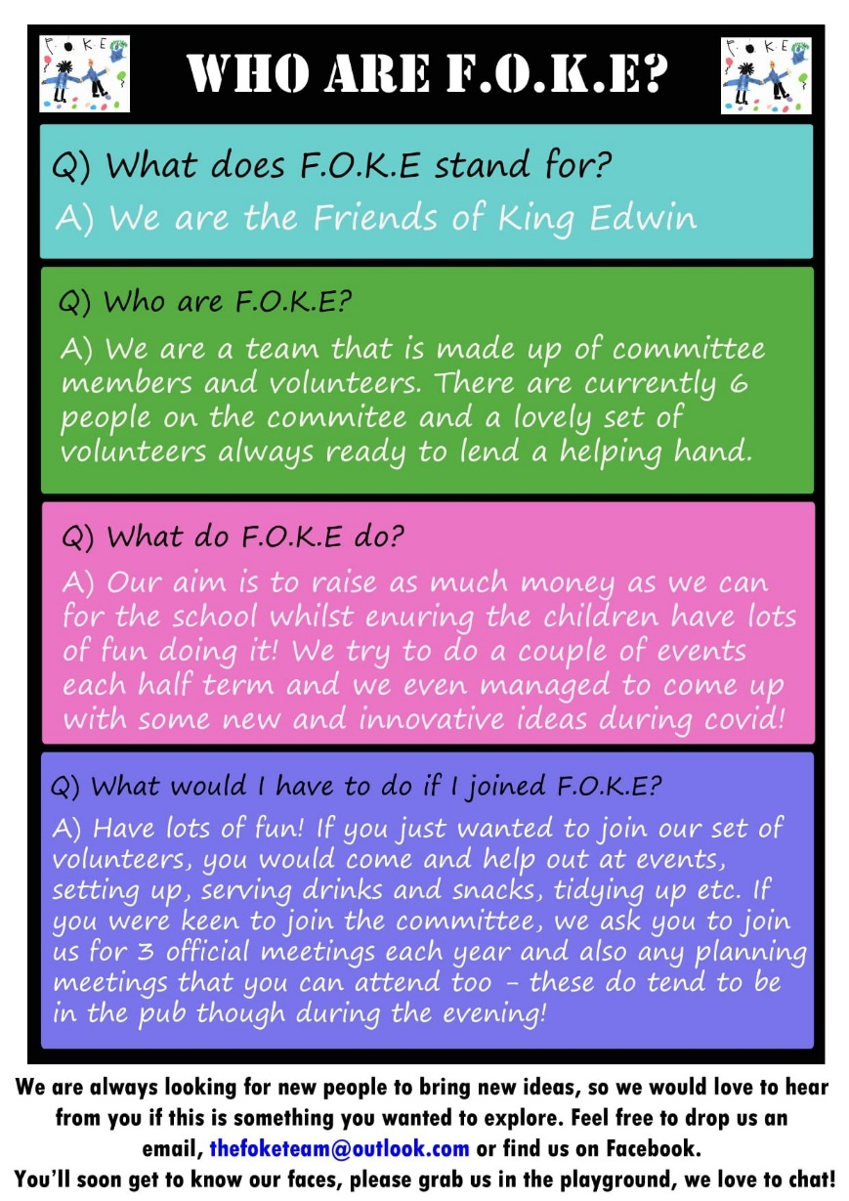
LM

Slide 21
SS
Medical
First day of school
Visits
Book bags

