Slide 1
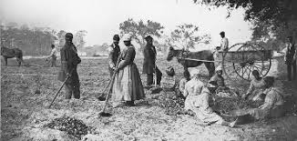
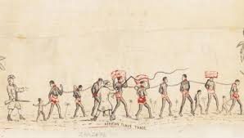
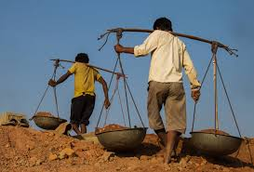
King Edwin Primary School
Main Learning: Slavery | Year 5 | Subject: History
Key knowledge
Know what it means to be a slave
Know where slaves came from​
Know where slaves were taken to​
Know why black people were enslaved​
Know about how slaves were treated​
Know about the people that tried to stop slavery​
Vocabulary
Race | A group of people identified as distinct from other groups because of physical or genetic traits shared by the group
Slavery | A system of people working hard for no money and being ‘owned’ by a wealthy person​
Freedom | The right to act, speak, or think as one wants
Abolishment | To put an end to (slavery)
Inherently inferior | A belief that black people were less important than white people
Atlantic slave trade | The transportation by slave traders of various enslaved African people, mainly to the America​
 | Prior Knowledge –

