Slide 1
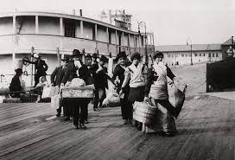
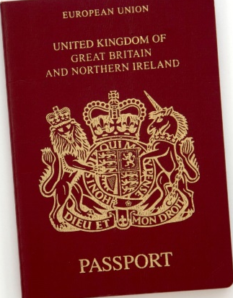
King Edwin Primary School
Main Learning: Immigration to North America | Year 5 | Subject: Geography
Key knowledge
Know why people decided to resettle
Know the main reasons why people would decide to move from the country they live
Know why immigration has been important for the USA
Know why immigration has been important for the UK
Know how people moving to another country often recreate their cultural heritage
Know about the importance of immigration to Australia
Vocabulary
Immigration | Arriving to live permanently in a different country.
Migration | Moving to a new area or country. This can be through choice or need.
Refugee | A person fleeing conflict or danger.
Emigrate | To leave one country to settle in another.
Ellis Island | It served as the nation's major immigration station from 1892 to 1924,
Citizenship | Legal recognition that someone belongs to a particular place or country.
 | Prior Knowledge –

