Slide 1

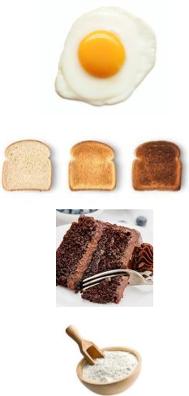

King Edwin Primary School
Main Learning: Reversible and irreversible changes | Year 5 | Subject: Science
Key knowledge
Know about materials that can or cannot be changed back to their original form once an action has been taken​
Know what a reversible change means​
Know what an irreversible change means​
Give examples of reversible and irreversible changes​
Know that some materials will dissolve in liquid to form a solution and describe how to recover a substance from a solution​
Use knowledge of solids, liquids and gases to decide how mixtures might be separated, including through filtering, sieving and evaporating ​
Vocabulary
dissolve​ | To become broken up or absorbed by something or to disappear into something else​
solubility​ | Is a chemical property referring to the ability for a given substance to dissolve in a solvent​
filtering​ | To pass a substance through a device which is designed to remove certain particles contained within​
melting​ | A physical process that results in the transition of a substance from a solid to a liquid​
separating​ | Separate, part, and divide mean to break into parts or to keep apart​
thermal​ | Something that is thermal is hot, retains heat, or has a warming effect​
 | Prior Knowledge –

