Slide 1
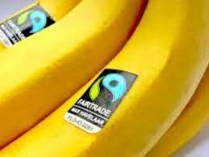
King Edwin Primary School
Main Learning: Fairtrade | Year 5 | Subject: Geography
Key knowledge
Know why Fairtrade is important to us all
Know how different countries trade with each other
Know why Brexit was important to all of us
Understand what people mean by Fairtrade
Know which countries suffer if there is not a culture of Fairtrade
Know what is meant by sustainability, global citizenship and ethical codes
Vocabulary
sustainability | Because our actions have a lasting effect on the environment and we should protect it for our future generations
global citizenship | Working as a community to look after the world
ethical codes | A set of moral principles used to govern the conduct of a profession
developing countries | A poor agricultural country that is seeking to become more advanced economically and socially
cooperatives | Groups of people who agree to work together to sell a product by following fair trade principles
Fairtrade premium | An extra sum of money to invest in improving the quality of their lives
 | Prior Knowledge –

