Slide 1
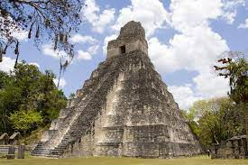
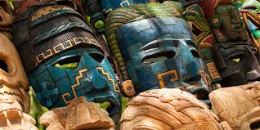
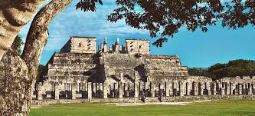
King Edwin Primary School
Main Learning: Mayans | Year 5 | Subject: History
Key knowledge
Know about the Mayans and what they gave society​
Know what was happening in Britain when the Mayans were most powerful​
Know how different the Mayans and the Egyptian pyramids were​
Know how the Mayans’ belief in Gods created a culture of sacrifice ​
Understand how the pok-ta-pok Mayan game could be described as the earliest football match​
Understand why the Mayans civilization died out​
Vocabulary
Chichen Itza​ ​ | The Mayans most well-known pyramid​
Itzamna​ ​ | The main god of the Maya, Itzamna was the god of fire who created the Earth​
codices​ ​ | Books, made of soft bark and folded like a fan, created by the Mayans​
ahau or ahaw​ | The main king or lord of a Maya city-state​
batab​ ​ | A lesser lord, usually ruling over a small town​
Kukulcan​ ​ | The serpent god of the Maya. One of the primary gods, especially to the Itza peoples of Chichen Itza​
 | Prior Knowledge –

