Slide 1
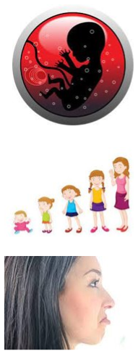
King Edwin Primary School
Main Learning: Life cycles of humans | Year 5 | Subject: Science
Key knowledge
Know about the life cycles of humans and various animals​
Know about the life cycle of a human being​
Know what the terms puberty, gestation and reproduction mean​
Vocabulary
puberty​ | Is the name for the time when your body begins to develop and change as you move from childhood to adulthood​
gestation​ | Is the time between conception and birth, during which the embryo is developing in the uterus​
embryo​ | Fertilisation happens when an egg cell meets with a sperm cell and joins with it. The fertilised egg divides to form a ball of cells called an embryo​
obese​ | Obesity is the condition of being much too heavy for one's height so that one's health is affected​
teenager​ | The age between thirteen and nineteen​
 | Prior Knowledge –

