Slide 1
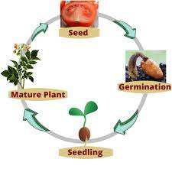
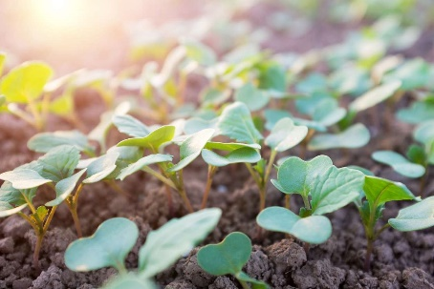
King Edwin Primary School
Main Learning: Life cycles in plants | Year 5 | Subject: Science
Key knowledge
Know about the life cycles of various animals​
Know the life cycle of different living things, e.g. mammal, amphibian, insect and bird​
Know about the process of reproduction in plants​
Know about the process of reproduction in animals​
Vocabulary
reproduction​ | Is the way different plants and animals make new plants and animals. The reproduction system differs in plants and animals​
Seed | The reproduction of a flowering plant, capable of developing into another such plant
Germination | The process by which an organism grows from a seed or spore
Growth | The process of increasing in size
Pollination | The transfer of pollen from an anther of a plant to the stigma of a plant, later enabling fertilisation and the production of seeds, most often by an animal or by wind
Flowering | The action of producing flowers
 | Prior Knowledge –

