Slide 1
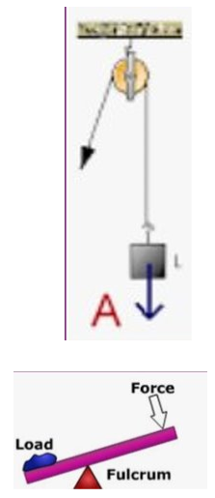
King Edwin Primary School
Main Learning: Forces | Year 5 | Subject: Science
Key knowledge
Know what a force is and how it impacts on the way things move​
Know what gravity is and its impact on our lives​
Identify and know the effect of air resistance​
Identify and know the effect of water resistance​
Identify and know the effect of friction​
Explain how levers, pulleys and gears allow a smaller force to have a greater effect​
Vocabulary
friction​ | A force between two surfaces that are sliding, or trying to slide, across each other​
gravity​ | A force which tries to pull two objects towards each other​
air resistance​ | A type of friction between air and another material. For example, when an aeroplane flies through the air​
water resistance​ | If you go swimming, there is friction between your skin and the water particles​
levers​ | A long rigid body with a fulcrum along its length​
pulleys​ | A simple machine and comprises of a wheel on a fixed axle, with a groove along the edges to guide a rope or cable​
 | Prior Knowledge –

