Slide 1
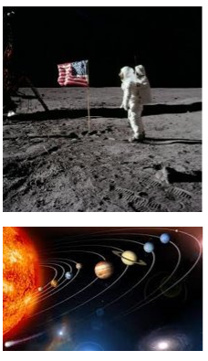
King Edwin Primary School
Main Learning: Earth and Space | Year 5 | Subject: Science
Key knowledge
Know about the Sun, Earth, moon and the plants​
Know about and explain the movement of the Earth and other planets relative to the Sun​
Know about and explain the movement of the Moon relative to the Earth​
Know and demonstrate how night and day are created​
Describe the Sun, Earth and Moon (using the term spherical)​
Know information about the planets​
Vocabulary
solar system​ | Is made of the eight planets that orbit our sun; it is also made of asteroids, moons, comets and lots more​
planet​ | There are 8 planets in our solar system, they are Mercury, Venus, Earth, Mars, Jupiter, Saturn, Uranus and Neptune​
spherical​ | Something spherical is like a sphere in being round, or more or less round, in three dimensions​
crescent moon​ | It is a slither of the moon that is lit up and can be seen and is less than half the moon​
gibbous moon​ | A gibbous moon occurs when the moon is three-quarters lit up​
eclipse​ | This occurs when an astronomical object is temporarily obscured. A lunar eclipse happens when the Earth moves between the Sun and the Moon and blocking the Sun's rays from striking the Moon​
 | Prior Knowledge –

