Slide 1
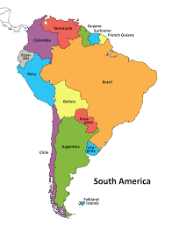
King Edwin Primary School
Main Learning: South America | Year 5 | Subject: Geography
Key knowledge
Know where South America is and what its main geographical features are.
Know and locate a number of South American countries
Find out about Brazil’s key features, including human and physical issues
Know about fruits and natural resources that South American countries have
Know what is meant by the term ‘street children’
Know key physical and human characteristics of a chosen location in South America
Vocabulary
pampas | The pampas are fertile South American lowlands that cover more than 750,000 km²
Incas | The Incas, an American indigenous people, were originally from the southern highlands of Peru.
street children | Groups of children with no homes or parents who are forced to beg for a living
anaconda snake | Semiaquatic snakes found in tropical South America
Andes | world's longest continental mountain range
I am somebody | poem which was used in a campaign to bring attention to the street children of Brazil
 | Prior Knowledge –

