Slide 1
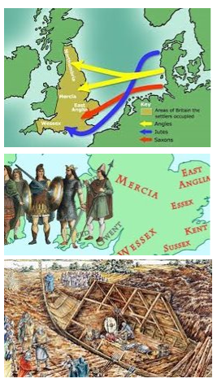
King Edwin Primary School
Main Learning: End of Roman occupation | Year 5 | Subject: History
Key knowledge
Know how Britain changed between the end of the Roman occupation and 1066​
Know why the Romans left Britain​ ​
Know who the Anglo-Saxons were and how they divided Britain up​
Know who the Vikings were and how they battled with the Anglo-Saxons​
Know how many of the words we use today originate from the Anglo-Saxons or the Vikings​
Know how the Vikings and Anglo-Saxons improved Britain​
Vocabulary
Anglo-Saxon kingdoms​ | The Anglo-Saxons formed many regions each with one ruler, known as kingdoms​
Shire reeve​ ​ | The peace officer of a shire, later known as ‘sheriff’.​
churl​ ​ | A lower-class Anglo-Saxon but better than a slave​
longship​ | The narrow boat used by Vikings to raid along coasts​
longhouse​ ​ | A large hall-like building where many Viking families would live together​
Jorvik​ ​ | The Viking name for the city of York. York now has a famous Viking museum called Jorvik​
 | Prior Knowledge –

